Slide 1


Slide 2
Part 1: Tools

Slide 3
-Rpass

Slide 4
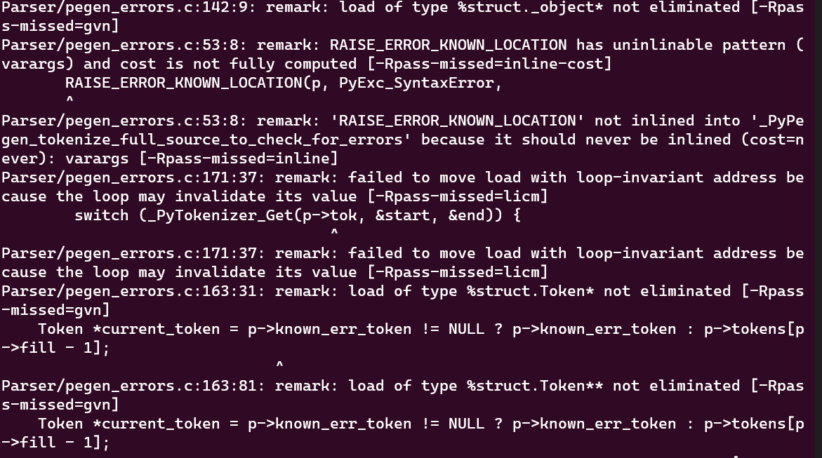
-Rpass sample output

Slide 5
-Rpass
llvm-opt-report

Slide 6
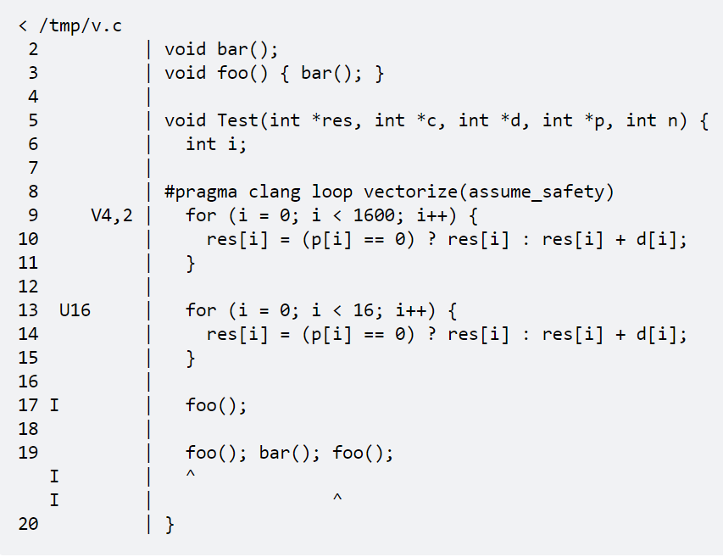
llvm-opt-report
https://reviews.llvm.org/D25262
https://github.com/llvm/llvm-project/tree/main/llvm/tools/llvm-opt-report

Slide 7
-Rpass
llvm-opt-report
opt-viewer

Slide 8
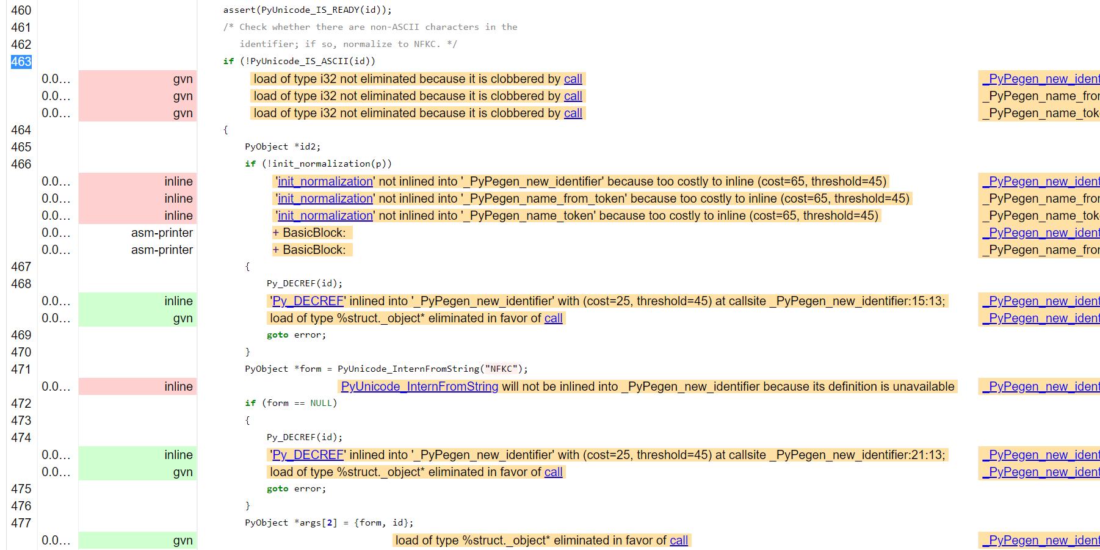
opt-viewer sample output

Slide 9
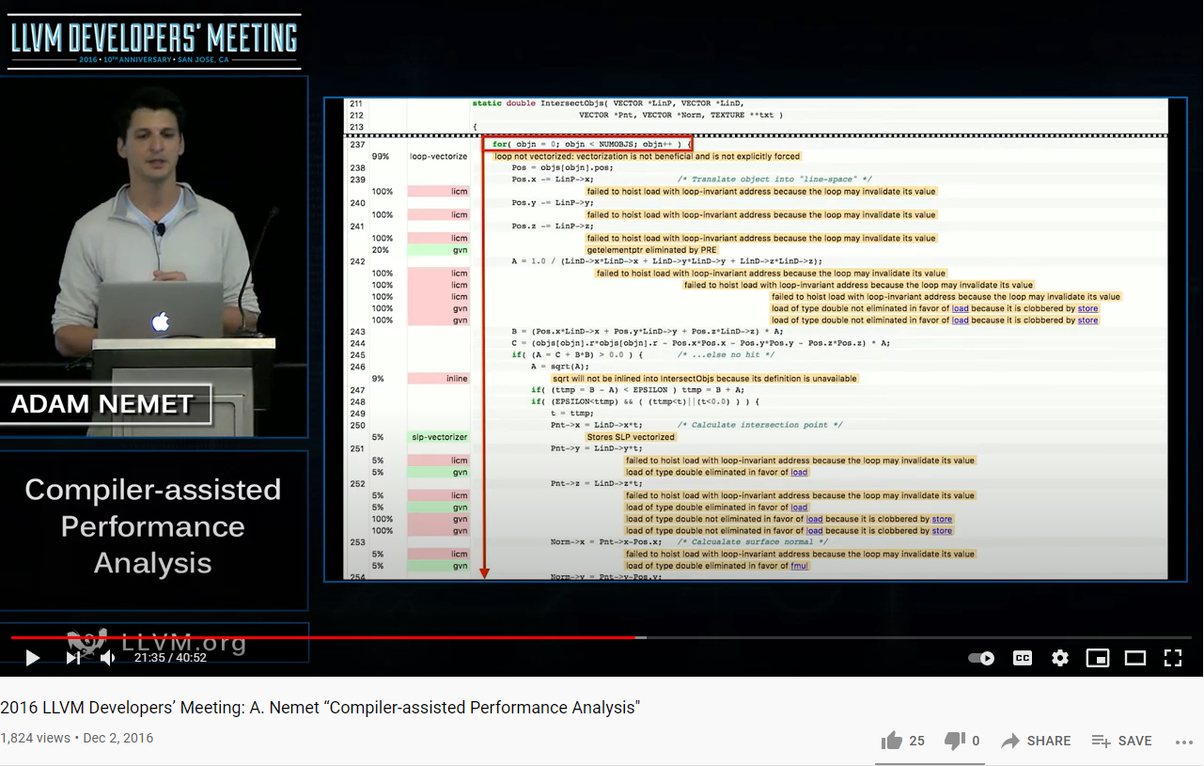
opt-viewer
2016 work led by Adam Nemet (Apple) https://www.youtube.com/watch?v=qq0q1hfzidg
Part of LLVM master: https://github.com/llvm/llvm-project/tree/main/llvm/tools/opt-viewer
Downloadable via deb pkg: llvm-14-tools
Notes:
Clang-only

Slide 10
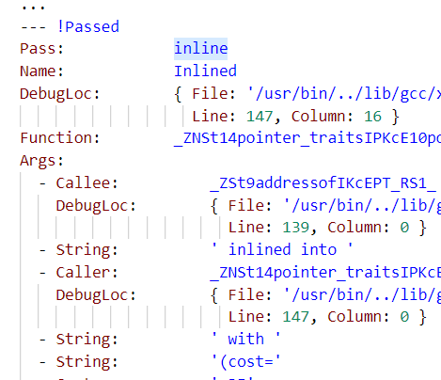
opt-viewer Usage
Build with an extra clang switch: -fsave-optimization-record
*.opt.yaml files are generated, by default in the obj folder.
Generate htmls:
$ opt-viewer.py --output-dir <htmls folder> --source-dir <repo> <yamls folder>

Slide 11
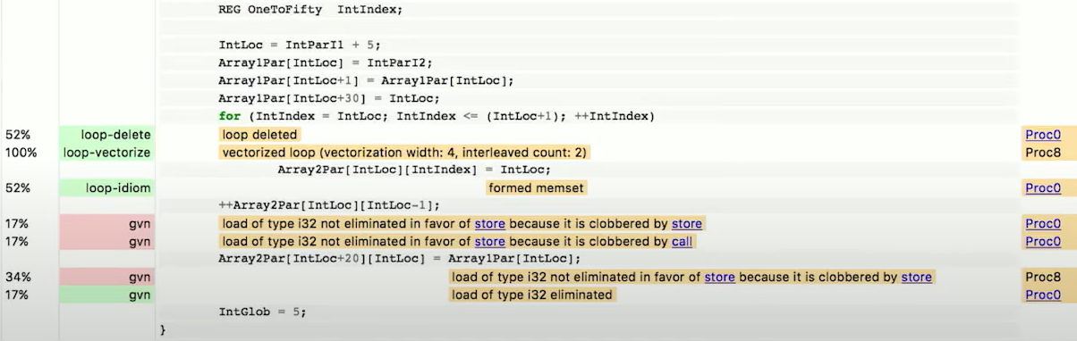
opt-viewer additions over -Rpass
Hotness
(PGO)
Inlining context

Slide 12
Great work, but
Heavy
High I/O
High memory
>1G htmls
Designed (and presented) for compiler authors
Mostly non actionable to developers

Slide 13
-Rpass
llvm-opt-report
opt-viewer
OptView2

Slide 14
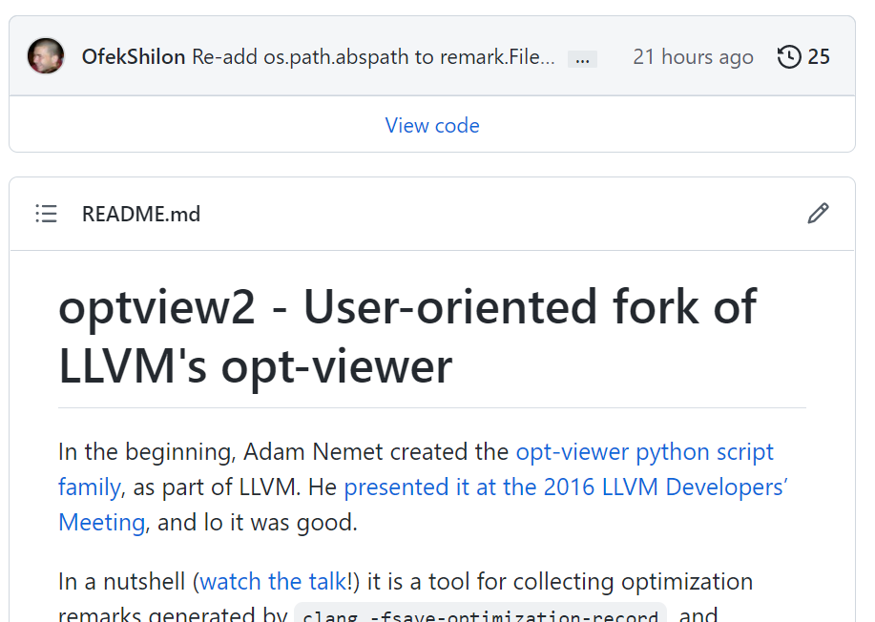
Introducing OptView2
https://github.com/OfekShilon/optview2

Slide 15
Target Developers, Not Compiler Authors
Denoise:
Collect only optimization failures
By default no system headers
Remove duplicities,
Filter comment types via config file/command line
~1.5M lines ==> 22K lines
Include column info (location within line)
split-to-subfolders
Sortable, resizable & pageable index
...

Slide 16
Example OptView2 outputs
https://ofekshilon.github.io/optview2-opencv/
https://ofekshilon.github.io/optview2-cpython/
https://ofekshilon.github.io/optview2_mujoco/

Slide 17
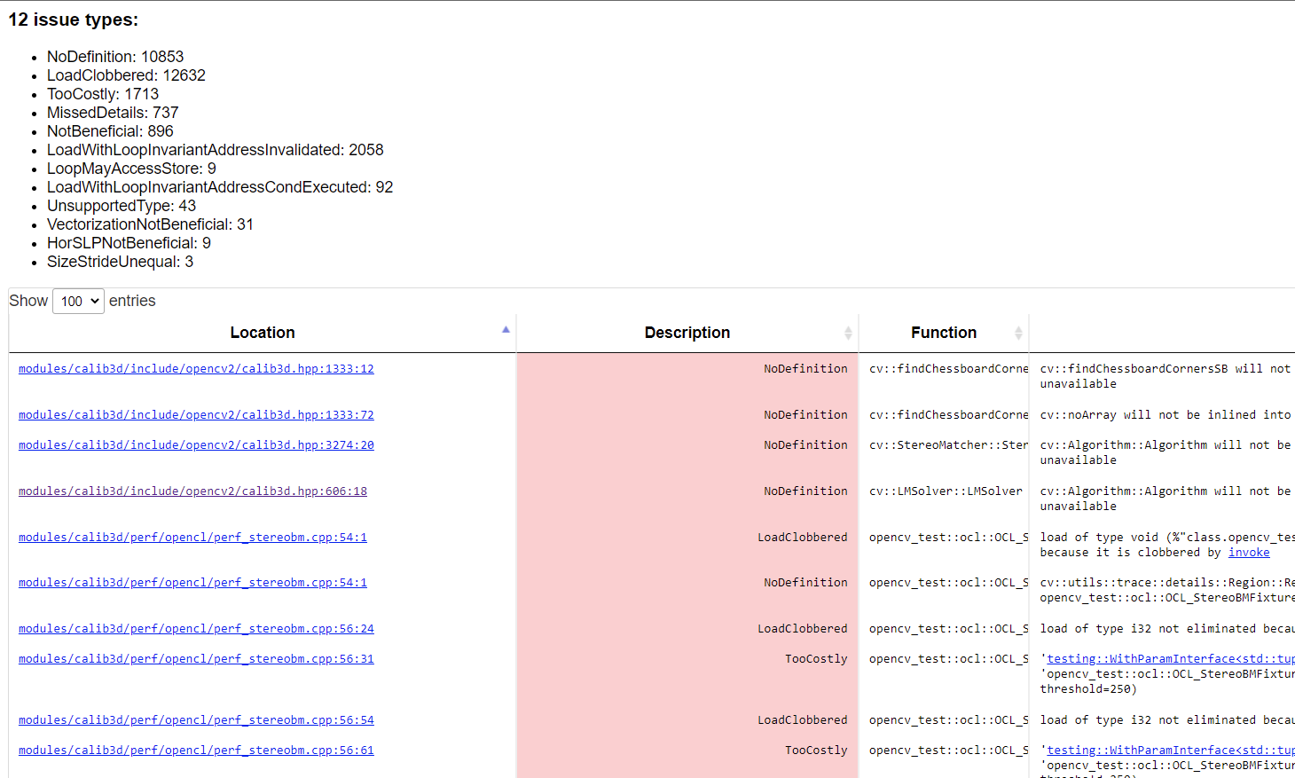
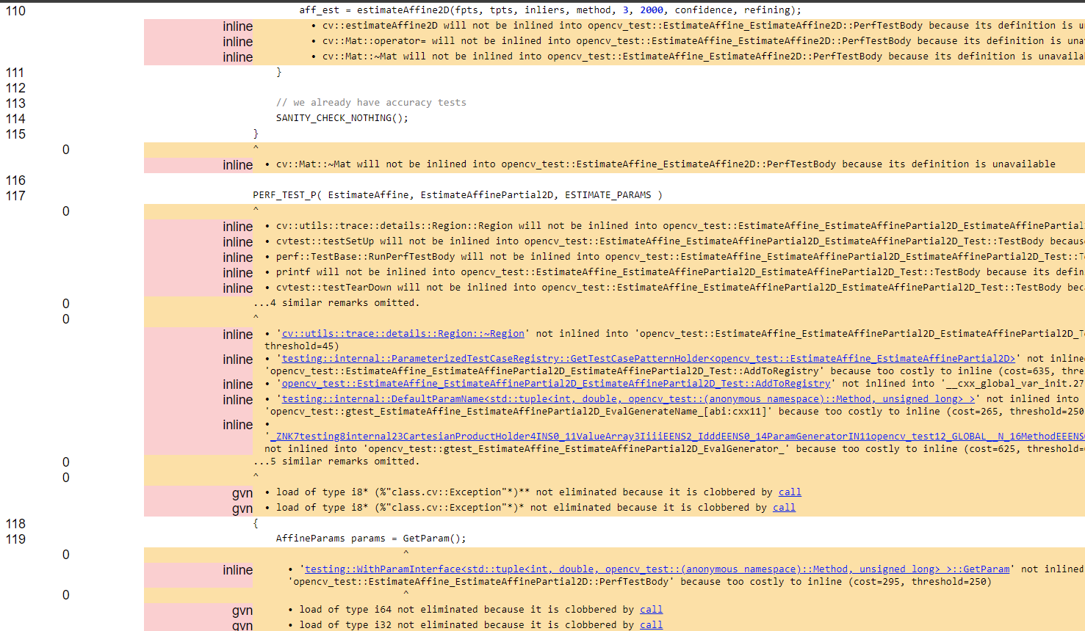
Example OptView2 outputs

Slide 18
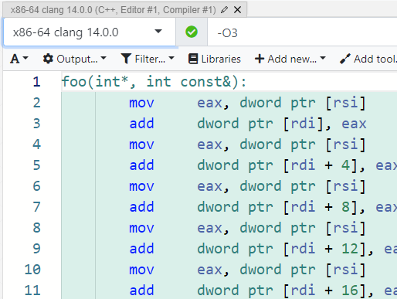
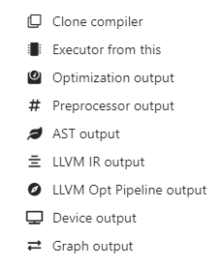
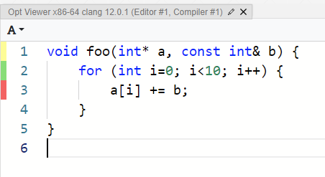
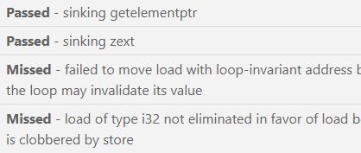
(Mostly) available in godbolt!

Slide 19
Part 2: Usage

Slide 20
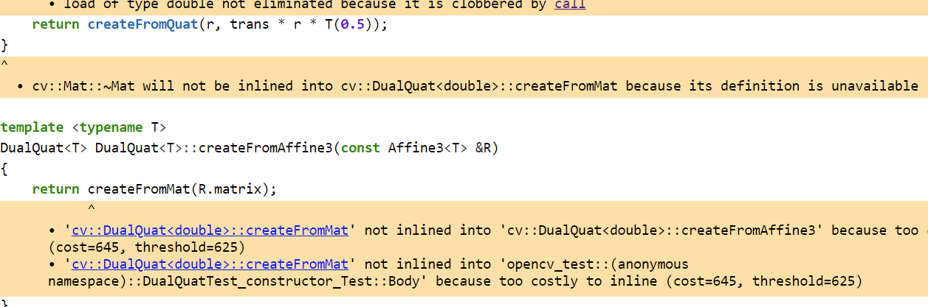
1. Inlining
https://ofekshilon.github.io/optview2-opencv/core/modules_core_include_opencv2_core_dualquaternion.inl.hpp.html#L80

Slide 21
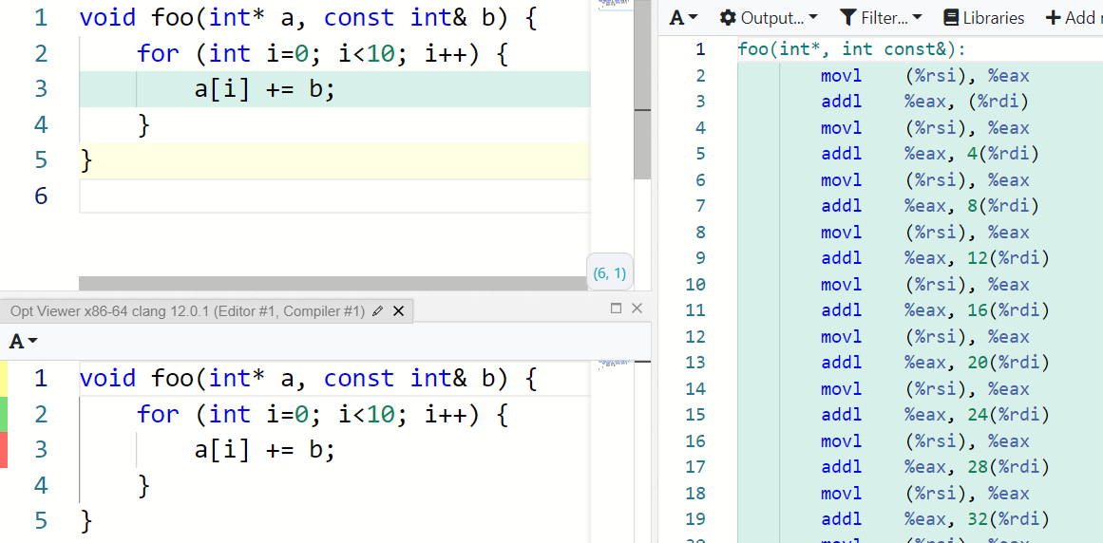
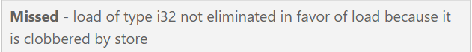
2. "Clobbered by store"
https://godbolt.org/z/T7h4nK3G7

Slide 22
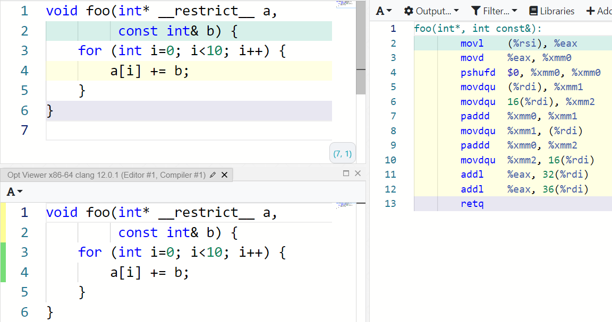
2. "Clobbered by store"

Slide 23
2. "Clobbered by store"
“Strict aliasing is an assumption made by the compiler, that objects of different types will never refer to the same memory location (i.e. alias each other.)” Mike Acton https://cellperformance.beyond3d.com/articles/2006/06/understanding-strict-aliasing.html
Perhaps can be ‘weaponized’ to communicate non-aliasing to the compiler?

Slide 24
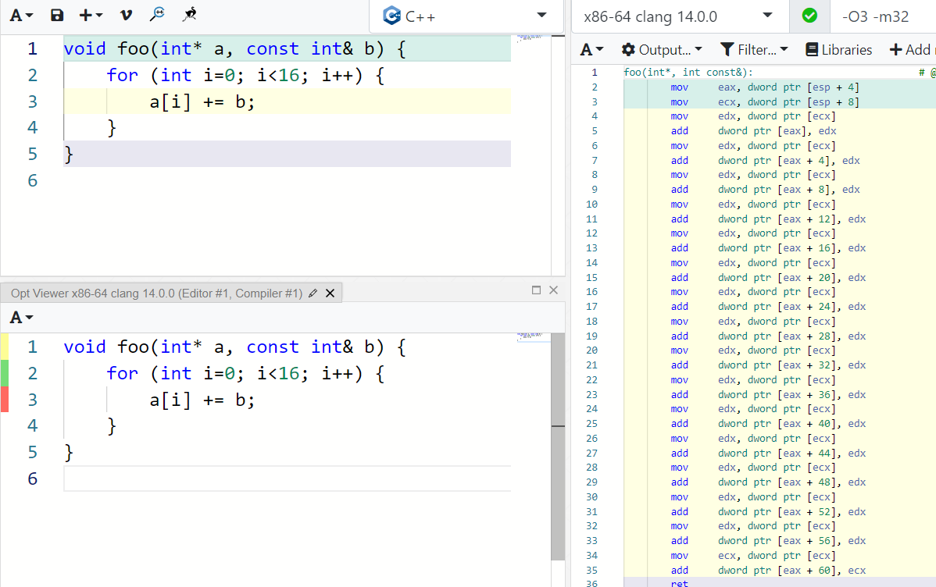
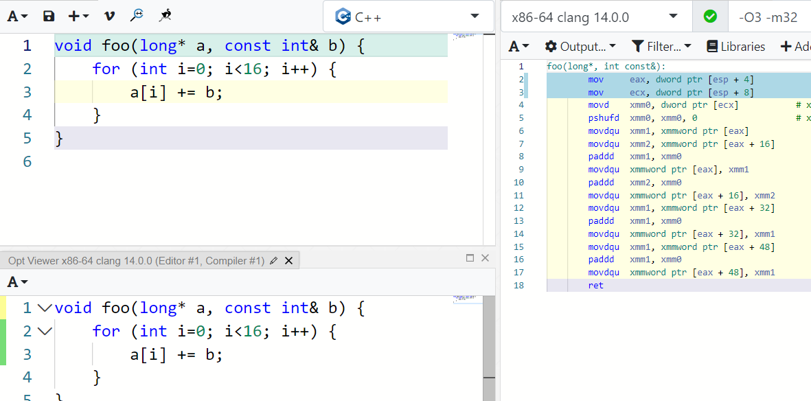
2. "Clobbered by store"

Slide 25
2. "Clobbered by store"
Maybe we can force artificial type-diff? Say, through some implementation of strong-typedef?
In practice, compilers are struggling.
Clang issue: https://github.com/llvm/llvm-project/issues/54646

Slide 26
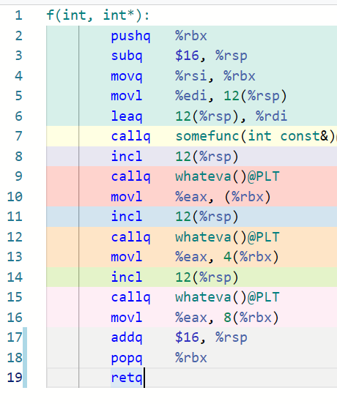
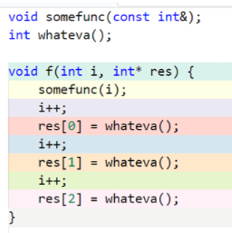
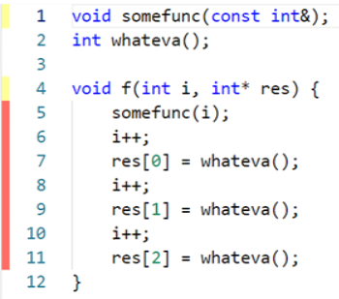

3. “Clobbered by call”
https://godbolt.org/z/jG5jq7c9a

Slide 27
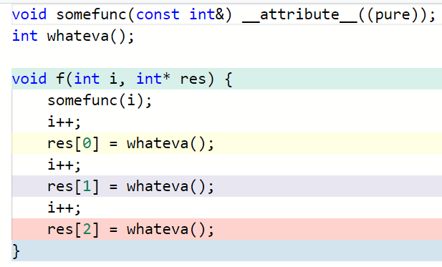
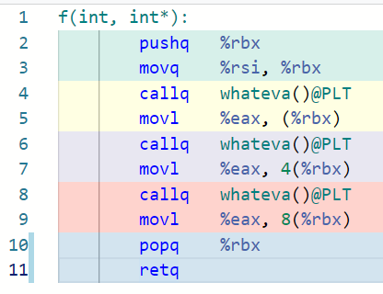
3. “Clobbered by call”
Cheating?.. pure + returns void somefunc() – does nothing, removed entirely.
If returned non-void – wouldn’t work (clang issue: https://github.com/llvm/llvm-project/issues/53102)

Slide 28
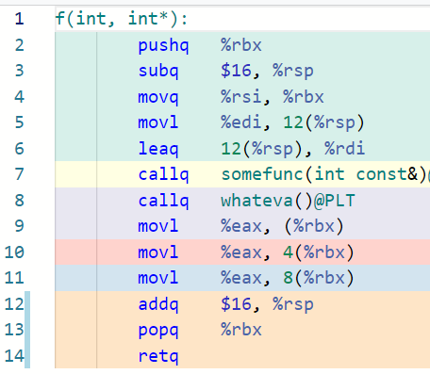
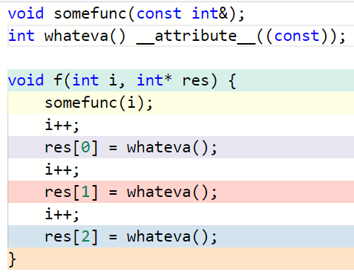
3. “Clobbered by call”
Whateva() called only once, result copied to 2 other places

Slide 29
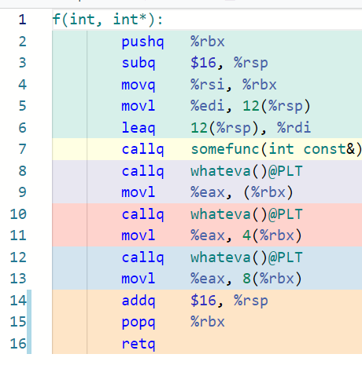
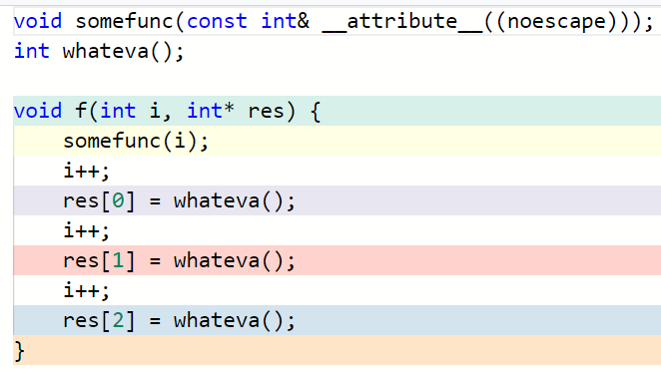
3. “Clobbered by call”

Slide 30
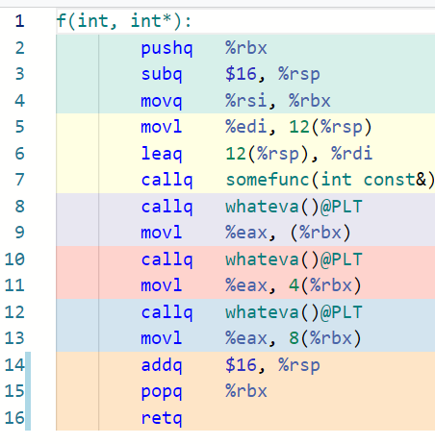
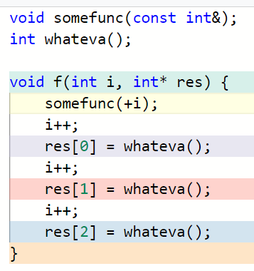
3. “Clobbered by call”

Slide 31
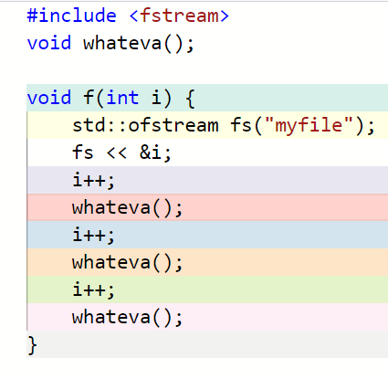
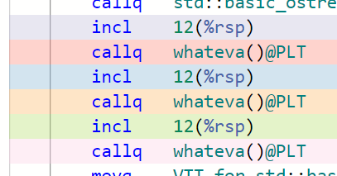
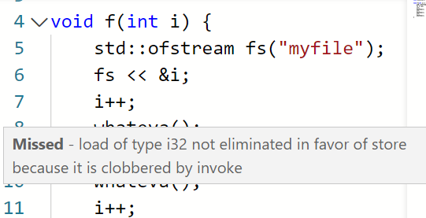
3. “Clobbered by call”
Sometimes the offending call is standard! https://godbolt.org/z/81319zq1E

Slide 32
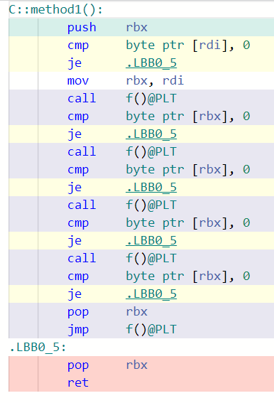
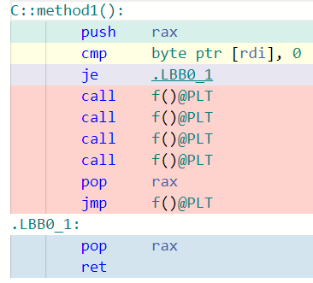
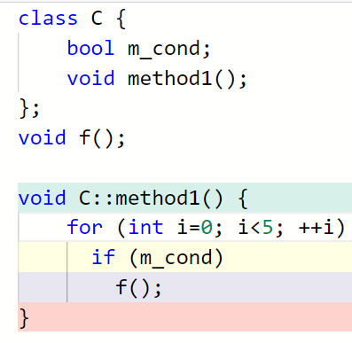
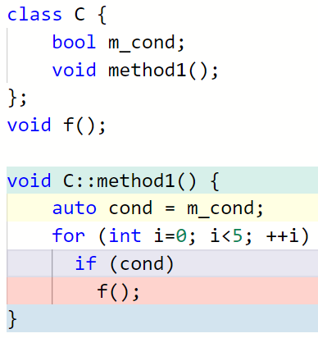

4. “Failed to move load with loop invariant address”
https://godbolt.org/z/YGc83TMnj
Notes:
Replace members with locals
NOT good c++ code!

Slide 33
Cheat Sheet
Symptom | Probable cause | Action
Inlining Failure |  | Add header / forceinline / increase threshold
"Clobbered by store" | Aliasing | restrict / force type diff
"Clobbered by load" | Escape | Attributes pure / const / noescape (typically before the remark site)
"Failed to move load loop invariant" | Aliasing / Escape | All the above + copy to local
* | Don’t understand? | Reduce to bare minimum in godbolt. Might be a compiler limitation.

Slide 34
Part 3: Other Compilers

Slide 35
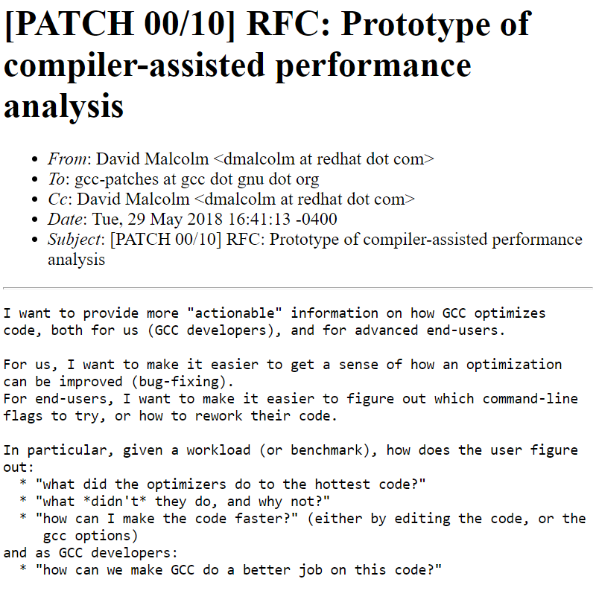
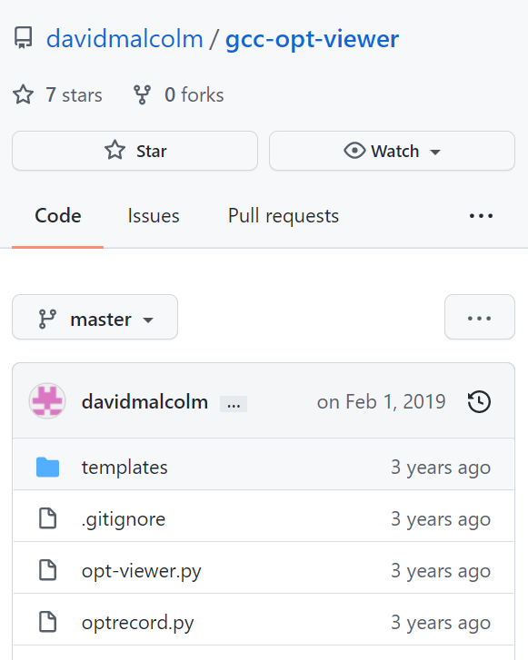
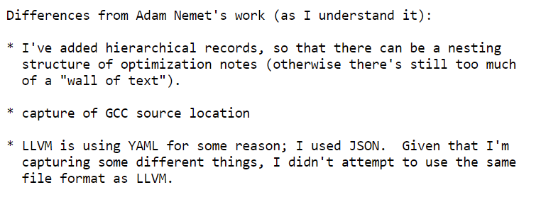
GCC work
https://gcc.gnu.org/legacy-ml/gcc-patches/2018-05/msg01675.html
https://github.com/davidmalcolm/gcc-opt-viewer

Slide 36
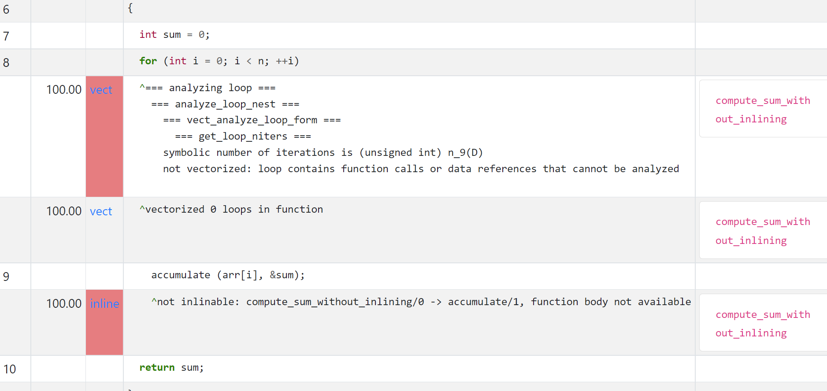
GCC work
https://dmalcolm.fedorapeople.org/gcc/2018-05-18/pgo-demo-test/pgo-demo-test/

Slide 37
GCC work
Active only during 2018
Still at prototype quality
Compilation might consume 10G+ RAM per single file
Python scripts often break
Opened two bugs, one solved in my fork
Notes:
Definitely needs some lovin, Hopefully can still be resurrected.

Slide 38
Decorations across compilers
* Pertains also to locals
** Decorates a function return value
clang | gcc | icc | msvc
__restrict | V | V | __restrict * __declspec(restrict) **
__attribute__((pure)) | V | - | -
__attribute__((const)) | V | V | __declspec(noalias)
__attribute__((noescape)) | - | - | -

Slide 39
Impact?
Personal experience: 6 µs -> 4.6 µs
PETOSPA: …. Optimistic Static Program Annotations (Doerfert, Homerding, Finkel 2019) https://github.com/jdoerfert/PETOSPA/blob/master/ISC19.pdf
~15%-20% speedup
ORAQL: Optimistic Responses to Alias Queries in LLVM (Hückelheim, Doerfert 2021) https://www.youtube.com/watch?v=7UVB5AFJM1w
No impact
Recommendations:
Concentrate on known bottlenecks,
Invest when you work at sub-millisecond scale, or in very tight loops.

Slide 40
Bottom line
The compiler can talk to you.
You can learn to listen.
And even answer.
Sometimes.

Slide 41

Come join the party!
https://github.com/OfekShilon/optview2
ofekshilon@gmail.com
@OfekShilon

Slide 43
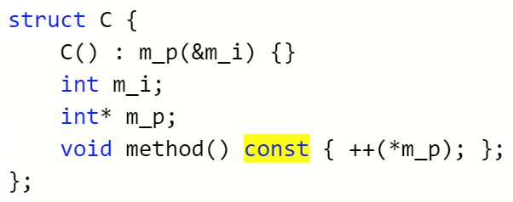
Can `const` methods help?
Does not guarantee that members don’t change!
A convenience service for the developer, not for the compiler.

Slide 44
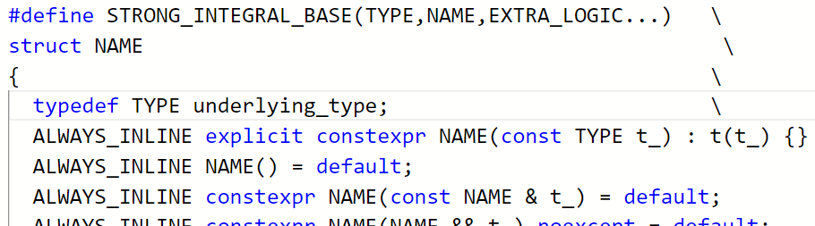
Weaponizing Strict Aliasing: Forcing type difference
Strong-Typedefs
Typical motivation: enhancing overload resolution and type safety
Despite some attempts (eg ‘opaque typedefs’), no standard solution
A handful of libraries exist, all using wrappers:

Slide 45
Strong-typedefs impact
Improves optimization:
https://godbolt.org/z/r8aWfMGfx
Degrades optimization:
https://godbolt.org/z/fe95sdrnx
Clang issue: https://github.com/llvm/llvm-project/issues/54646
Improves again: (enum classes hack, for integer-likes only)
https://godbolt.org/z/4nejY3dKs

Slide 46
4. “Failed to move load with loop invariant address”
Foreach or other <algorithm>s?
In this toy example – identical code.
https://godbolt.org/z/jYWhG6zWc
Occasionally different, not always better.

Slide 47
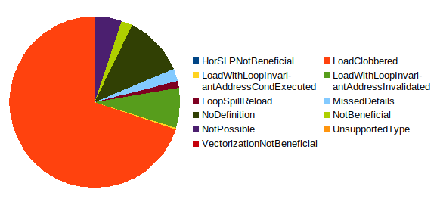
Impact?
Distribution in a real C++ project:

Slide 48
OptView2 wish list
Reduce run time & memory
Run on windows
Consume binary optimization remarks
Revive (possibly integrate) gcc-opt-viewer
Notes:
Report LLVM bugs:
alias analysis bugs had no observable symptoms until now. There are no diagnostics emitted on them and they don’t result in bad codegen
So, I suspect there are plenty of them.

Slide 49
Compiler wish list
-opt-remarks filtering, as in –Rpass (just failures, pass filter)
Pass to LTO linking phase
Enable opt-remarks for other languages?
Curious about rust aliasing behavior
Enhance ways to communicate non-aliasing
Accept ‘rectrict’ on local varibales, as in msvc?
Report names where available, not just types (“i32”)
Generate remarks during escape analysis passes
When reporting clobbering (==aliasing), differentiate “concrete potential flow with aliasing found” and “couldn’t prove anything”.
Notes:
At least 4 committee papers try to engage with aliasing in the language. Alias-set, provenance

Slide 50
OptView2 with LTO
Different Usage:
Build with LTO, use –v to dump the list of obj files used (containing only IR)
LLVM includes the tool llvm-lto. Use like this: $ llvm-lto -lto-pass-remarks-output=<yaml outputpath> -j=10 -O=3 <obj files list>
Creates a single huge yaml. No parallelism in creation or consumption by optview2.
Can somewhat reduce remarks volume with -lto-pass-remarks-filter=<regex>
Couldn’t get meaningful results for a large project.

Slide 51
OptView2 with LTO
Inlining -> non-issue.
Escape & Aliasing – still very much an issue.
“inter-procedural analyses are often less precise, due to uncertainty stemming from unknown outside callers… In LLVM, intra-procedural analyses are dominating in numbers and potential. The existing inter-procedural analyses mostly try to limit the possible effects of function calls and simplify the caller-callee interface through propagation of constants.. “ (Doerfert, Homerding, Finkel 2019)

